Slide 1
Probability & Statistics for Engineers & Scientists
Authors: Walpole, Myers, Myers, YE
Instructor:
Osama Bin Ajaz
Lecturer, S & H Dept.,
FAST-NU, Main Campus, Karachi
osama.ajaz@nu.edu.pk

Slide 2

Text Book →

Slide 3

Reference Book →

Slide 4
MT206 – Probability & Statistics (4 Credit Hours)
Course Outline:
Week | Topics
01 | Intro. To Statistics, Measures of Central Tendency & Dispersion
02 | Bar Chart, Histogram, Stem-Leaf Plot, Box Plot, Dot Plot, Frequency Curves, Ogive, Skewness & Kurtosis
03 | Introduction to Probability: Sample Space, Tree Diagram, Event, Set Theory, Venn Diagram
04 | Counting techniques, Kinds of Events, Additive rules
05 | Conditional Probability, Independence, Multiplicative rules, Bayes’ Theorem.
06 | 1st Mid-Term Examination

Slide 5
MT206 – Probability & Statistics (4 Credit Hours)
Course Outline (Contd.)
Week | Topics
07 | Random Variables & Probability Distributions: PMF, PDF, CDF, Joint & Marginal Probability Distributions, Mathematical Expectation
08 | Discrete Distributions: Binomial & Multinomial, Poisson, Geometric, Hypergeometric, and Discrete uniform.
09 | Continuous Distributions: Normal, Exponential, Uniform, Chi-Square
10 | Testing of Hypothesis: z-test, t-test
11 | Goodness of Fit Test, Chi-Square test of Independence
12 | 2nd Mid-Term Examination

Slide 6
MT206 – Probability & Statistics (4 Credit Hours)
Course Outline (Contd.)
Note: The above course outline & schedule is tentative.
Week | Topics
13 | Correlation & Regression
14 | Non-Linear Regression: Polynomial regression
15 | ANOVA
16 | Final Examination

Slide 7
Marks Distribution
S. No. | Particulars | % Marks
01 | Assignments | 10
02 | Quizzes (Unannounced) | 10
03 | 1st Mid Term | 15
04 | 2nd Mid Term | 15
05 | Final Exam | 50
Total |  | 100

Slide 8
Important Instructions
Be in the classroom on time.
All students are required to maintain 80% of attendance. In case students fail to maintain 80% of attendance, they become ineligible to take the final exam.
Turn off your cell phones or any other electronic devices before entering the class.
Maintain the decorum of the class room all the time.
Avoid conversation with your classmates while the lecture is in progress.
Submit your assignments on time otherwise marks will be deducted after deadline.

Slide 9

Important Instructions (Contd.)
Assignment should include a title page consisting of your complete Name, Roll No, Subject Name and date etc.
Assignment should be submitted in the Holes clip punch folder (snap attached).
Incomplete assignments lead to reduction in marks.
Avoid plagiarism.
For Quizzes bring your own loose pages.
Violation of any instructions leads to a reduction in marks.

Slide 10
Please do not ask for lectures slides.
Do follow recommended books.
Thank you

Slide 11
Introduction to Statistics

Slide 12
Introduction to Statistics
What does the word statistics bring to mind?
If you read newspapers, surf the Web, watch the news on television, or follow sports, you see and hear the following statements:
10 year inflation rates.
Population growth rate, Birth and Death rates etc.
Exchange rates, Stock prices etc.
Census & Survey
Average Run rate of a player
Ranking of Cricket players.
Average salary of programmers.

Slide 13
Definition of Statistics
The Science of collection, presentation, analysis and
Interpretation of numerical (or non-numerical)
facts & data.

Slide 14
Descriptive & Inferential Statistics
Descriptive statistics consists of methods for organizing and summarizing information.
It includes the construction of graphs, charts, tables, and computation of averages, variations, and percentiles.
Inferential Statistics consists of methods for drawing and measuring the reliability of conclusions about a population based on information obtained from a sample.
When an inference is made about the population, then the study becomes inferential.

Slide 15
Further Classifying Statistical Studies
Observational Study: researchers simply observe characteristics and take measurements, as in a sample survey.
Designed experiment: researchers impose treatments and controls and then observe characteristics and take measurements.
Observational studies can reveal only association, whereas designed experiments can help establish causation.

Slide 16
Statistical Terminologies
Population: The collection of all individuals or items under consideration in a statistical study.
Sample: That part of the population from which information is obtained.
Random Sample: it is a sample selected in such a way that every member of the population has an equal chance of being selected.
Parameter: it describes characteristics of a population.
Statistic: it describe characteristics of a sample.

Slide 17
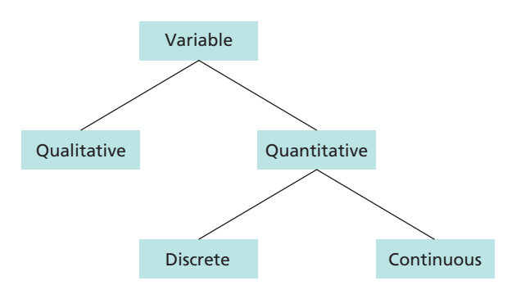
Statistical Terminologies

Slide 18
Types of Data
Primary Data: it is also called Raw Data or First hand information such as Census & Survey questionnaires etc.
Secondary Data: that is already collected by someone else such as published reports of research organizations.

Slide 19
Measurement Scales
Nominal Scale: Classification into mutually exclusive qualitative categories such as Male & Female, Muslims & Non-Muslims, Profession, Blood group etc.
Ordinal Scale: It includes the characteristic of a nominal scale and in addition has the property of ordering or ranking of measurements. For example: Performance of students, Customer ratings (strongly agree, agree, neutral, disagree, strongly disagree) etc.
Interval Scale: it includes those quantitative variables for which zero is not meaningful. For example: Temperature, IQ score etc.
Ratio Scale: It is the strongest scale and possess absolute zero. For example: Area, Volume, length, distance, weight, money etc.
Notes:
How variables are defined and categorized?
Temperature e.g. = [20 (68*F) , 30 (86*F)] & [5 (41*F), 15 (59*F) ]

Slide 20
Classify following variables as discrete or continuous
The Life time of a laptop component.
The number of heads in toss of 4 coins.
The amount of milk produced by a cow.
The number of enrollment in statistics class.
The age of a programmer.
Processing speed of a software.
The number software crashes in 3 hours.
Continuous
discrete
Continuous
discrete
Continuous
Continuous
discrete

Slide 21
Classify as Qualitative or Quantitative
Average Salary of Software Engineers in East Asia.
Marks of 40 students of a statistics class.
Program preferences of a talk show.
Religion of peoples in a country.
Quantitative
Quantitative
Qualitative
Qualitative

Slide 22
Classify scales of measurements
Rankings of golfers in a tournament
Temperatures inside 10 pizza ovens.
Weights of selected cell phones
Salaries of the coaches in the NFL.
Ratings of textbooks (poor, fair, good, excellent).
Age of children in a day care center­­­­
Categories of magazines in a physician’s office (sports, women’s, health, men’s, news)

Slide 23
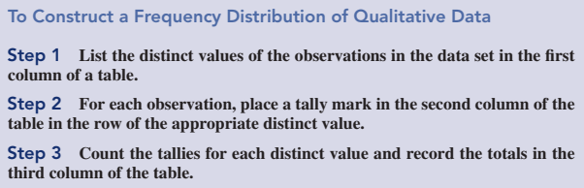
Frequency Distribution
A frequency distribution of qualitative data is a listing of the distinct values and their frequencies.

Slide 24
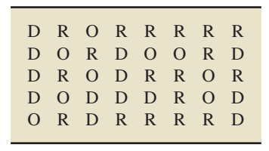
Example # 01: Qualitative Freq. distribution
The following data represents the political party affiliation of the students in introductory statistics course of a particular college in the USA. Organize these data into a frequency distribution.

Slide 25
Example # 02: Bar Chart for Qualitative Freq. distribution

Slide 26
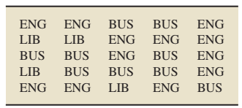
Example # 03: Qualitative Freq. distribution (Contd.)
The following table provides data on college for the students in one section of the course Introduction to Computer Science during one semester at Arizona State University. In the table, we use the abbreviations BUS for Business, ENG for Engineering and Applied Sciences, and LIB for Liberal Arts and Sciences.
Construct Frequency distribution and simple Bar chart.

Slide 27
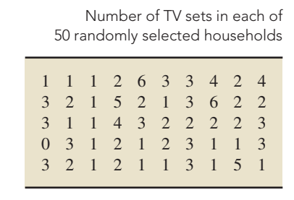
Example # 04: Quantitative Freq. distribution
Use single-value grouping to organize the following data into frequency and distribution.

Slide 28
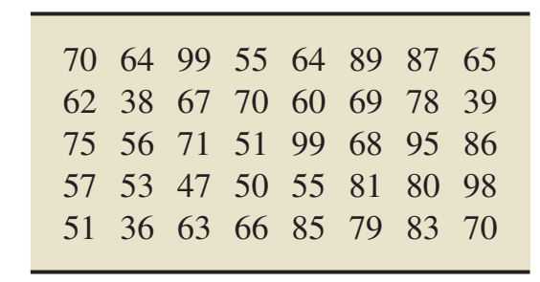
Example # 05: Group Frequency Distribution
The following data displays the number of days to maturity for 40 short-term investments. The data are from BARRON’S magazine. Use limit grouping, with grouping by 10s, to organize these data into frequency distribution.
Notes:
Minimum = 36, use first class (30 – 39), Maximum = 99, results in 7 classes.
h = (range/no. classes) & No. of classes = 1 + 3.3Logn

Slide 29
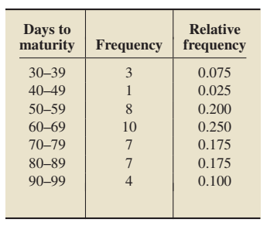
Example # 06: Histogram
Notes:
Frequency Polygon & OGIVE

Slide 30
Example # 07: Stem & Leaf Plot
Reconsider example # 05 and construct Stem & Leaf Plot.

Slide 31
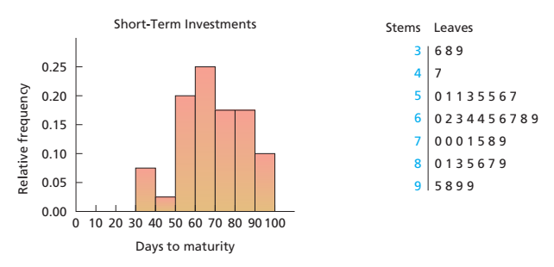
Example # 07: Stem & Leaf Plot (Contd.)
Stem & Leaf Plot is similar to Histogram:

Slide 32
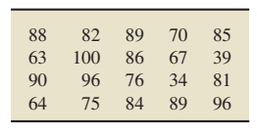
Example # 08: Dotplot
Dotplots are useful for showing the relative positions of the data in a data set or for comparing two or more data sets.
Construct a dotplot for the following exam scores of the students in an introductory statistics class.

Slide 33
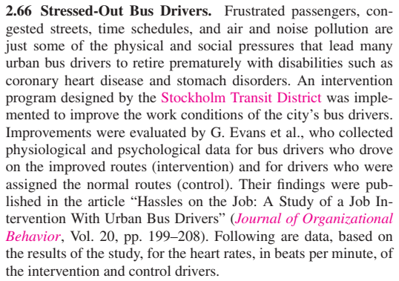

Slide 34
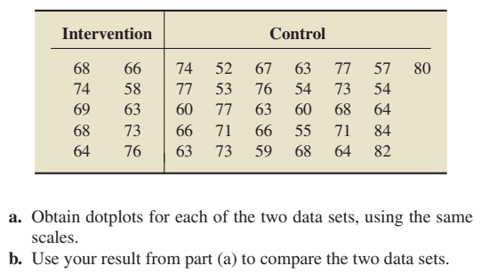
Stressed-Out Bus Drivers (Contd.)
Notes:
Neil A. Weiss

Slide 35
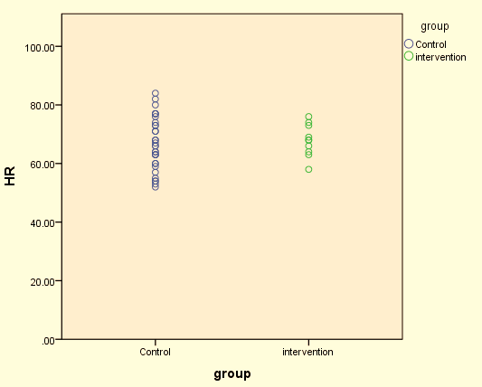
Stressed-Out Bus Drivers (Contd.)

Slide 36
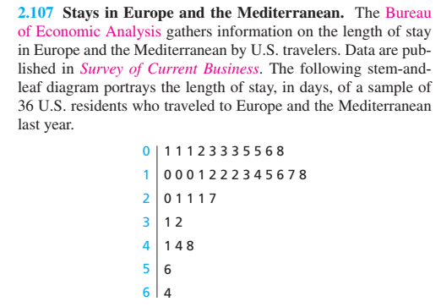
Convert the following into Freq. Distribution

Slide 37
Example # 09: Frequency Polygon & OGIVE
Reconsider example # 06 and construct frequency polygon & OGIVE:

Slide 38
Measures of Central Tendency (Mean, Median, Mode)

Slide 39
Example # 10: The Mean
Reconsider Example # 09:

Slide 40
Example # 11: The Median
Reconsider Example # 10 and calculate Median.

Slide 41
Example # 12: The Mode

Slide 42
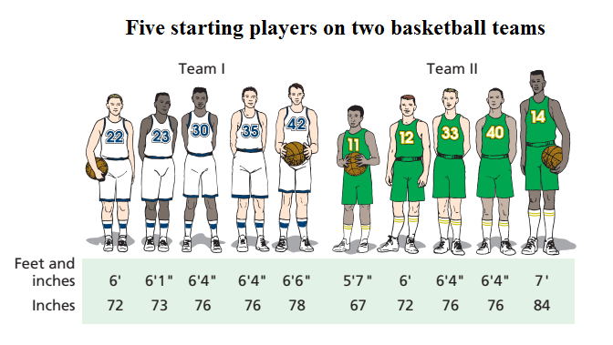
Measures of Variation
Two or more data sets can have same mean, median or mode, but those datasets may differ in other aspects.
Notes:
Mean = 75 inches (6.3) Median = 76 inches (6.4) Mode = 76 inches ( 6.4)

Slide 43
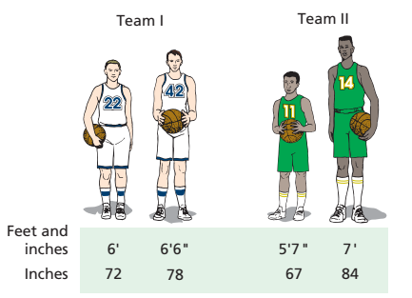
Measures of Variation: RANGE

Slide 44
Measures of Variation: The Standard Deviation

Slide 45
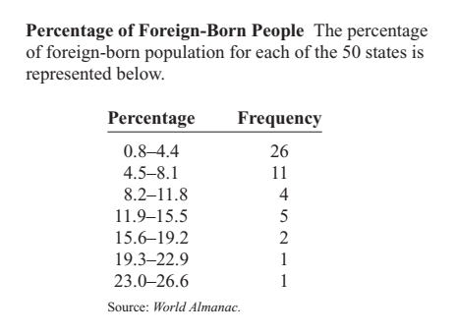
Calculate Mean, Median, Mode, SD, & draw Histogram (Quiz-I)
Notes:
Do you think the mean is the best average for this set of data?
For CB (0.05 +, -)

Slide 46
Calculate Mean, Median, Mode, CV, & draw OGIVE(Re-Quiz-I) 20/2/19

Slide 47
Calculate Q1,Q2,Q3,, & construct box plot (Re Re-Quiz-I) 22/2/19

Slide 48
Example 14:
Use the following data set: 10, 20, 30, 40, 50 to find:
Standard deviation
Add 5 to each value, and then find the SD.
(c) Subtract 5 from each value and find the standard deviation.
(d) Multiply each value by 5 and find the SD.
(e) Divide each value by 5 and find the SD.
Notes:
(a) 15.81 (b) 15.81 (c) 15.81 (d) 79.06 (e) 3.16

Slide 49

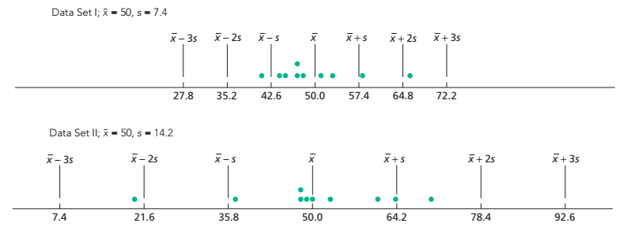
Further Interpretation of Standard Deviation
Notes:
(xbar + 2x) represents the number that is two standard deviations to the right of mean.

Slide 50
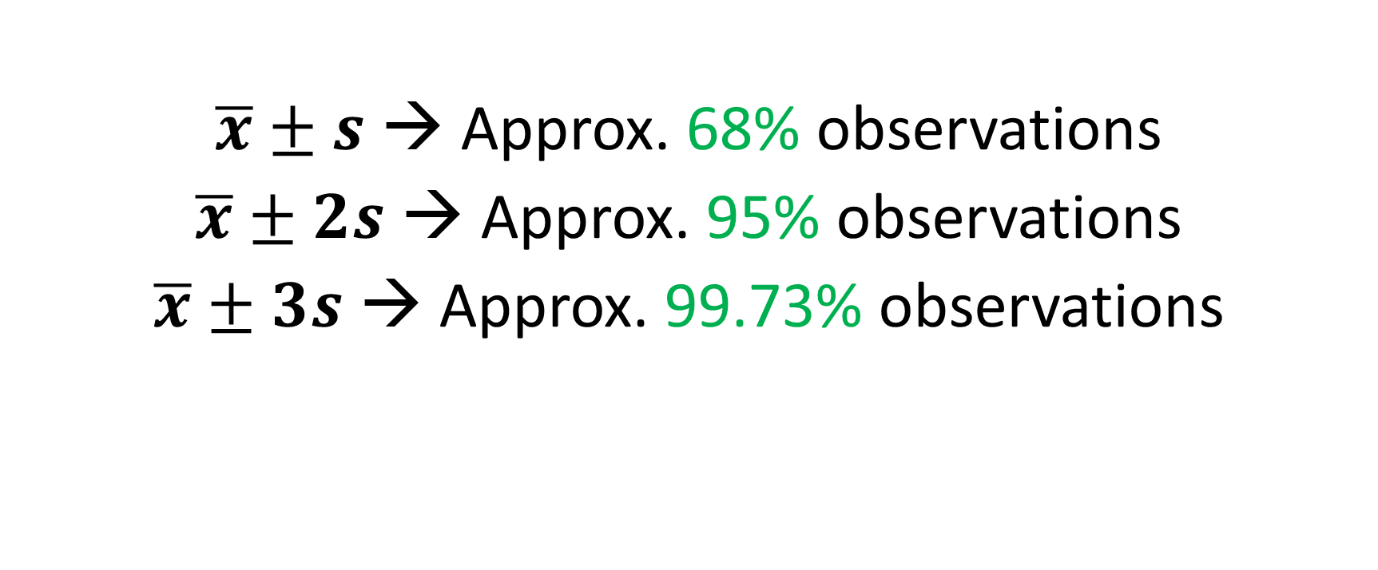
For a bell-shaped curve following empirical rule hold
$\overline{x}±s$ → Approx. 68% observations
$\overline{x}±2s$ → Approx. 95% observations
$\overline{x}±3s$ → Approx. 99.73% observations

Slide 51
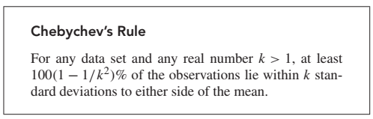
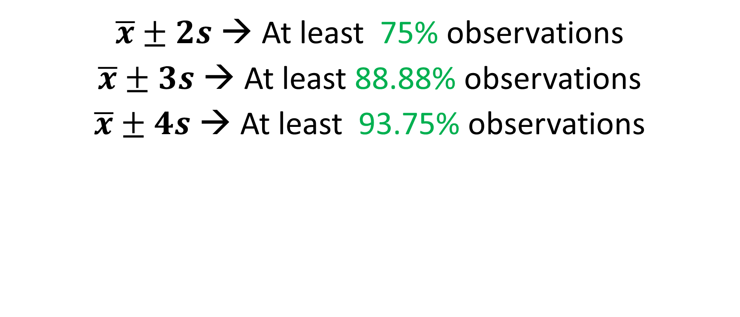
CHEBYCHEV’S RULE
$\overline{x}±2s$ → At least 75% observations
$\overline{x}±3s$ → At least 88.88% observations
$\overline{x}±4s$ → At least 93.75% observations

Slide 52
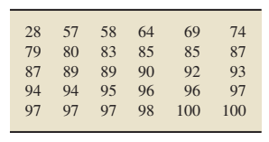
Example # 15: Exam Scores
Consider the following sample of exam scores,
arranged in increasing order. The sample mean and
Sample standard deviation of these exam scores are,
respectively, 85 & 16.1.
Use Chebychev’s rule to obtain a lower bound on the percentage of observations that lie within two and three standard deviations to either side of the mean.
Use the data to obtain the exact percentage of observations that lie within two standard deviations to either side of the mean. Compare your answer.

Slide 53

Measures of Variation: The Coefficient of Variation
A statistic that allows you to compare standard deviations when the units are different is called the coefficient of variation.
Example # 16

Slide 54
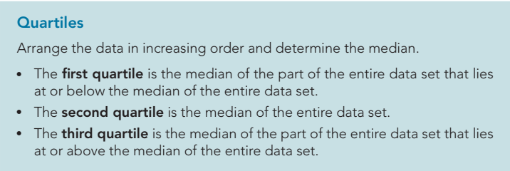
Quartiles

Slide 55
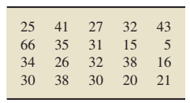
Example # 17: Quartiles (Contd.) (Weekly TV-Viewing Times)
The A. C. Nielsen Company publishes information on the TV-viewing habits of Americans in Nielsen Report on Television. A sample of 20 people yielded the weekly viewing times, in hours, displayed in the table below. Determine and interpret the quartiles for these data.
Solution:
Notes:
Q1 = 23, Q2 = 30.5, Q3 = 36.5
Skip 66 for calculating Quartiles for odd numbers: Q1 = 21, Q2 = 30, Q3 = 35
IQR = Q3 – Q1

Slide 56
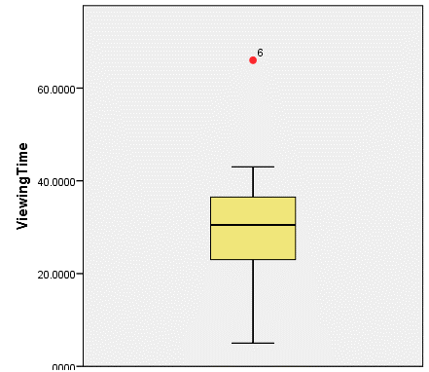

Example # 18: Box Plot
It represents 5 number summary:
Reconsider Weekly Viewing Times data:
Notes:
L = Q1 – 1.5(IQR) = 2.75 U = Q3 + 1.5(IQR) = 56.75
Q1 = 23, Q2 = 30.5, Q3 = 36.5
25% TV viewing times are less than 23hours, 25% are b/w 23 and 30.5 hours, 25% are b/w 30.5 & 36.5 hours, 25% are greater than 36.5hours.

Slide 57
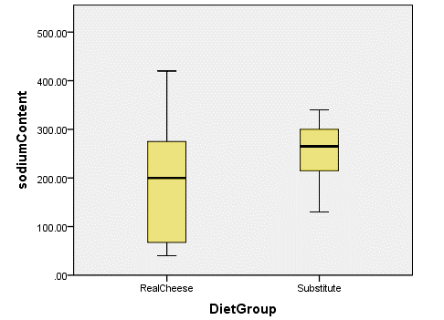
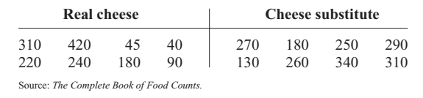
Example # 19: Box Plot
A dietitian is interested in comparing the
sodium content of real cheese with the
sodium content of a cheese substitute.
The data for two random samples are shown.
Compare the distributions, using boxplots.
Notes:
Real Cheese: Q1=67.5, Q2=200, Q3=275, Min=40, Max=420
Cheese Substitute: Q1=215, Q2, 265, Q3=300, Min=130, Max=340

Slide 58
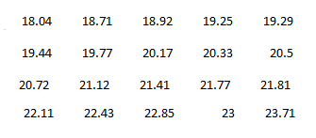
Trimmed Mean
According to the journal of Chemical Engineering, an important property of a fiber is its water absorbency. A random sample of 20 pieces of cotton fiber was taken and the absorbency on each piece was measured. The following are the absorbency values:
(a) calculate the sample mean and median for the above sample values.
(b) Compute trimmed mean.
Notes:
Q1 = 19.32, Q2=20.61, Q3=22.03, Mean = 20.76, Mode = 18.04
20Trimmed=

Slide 59
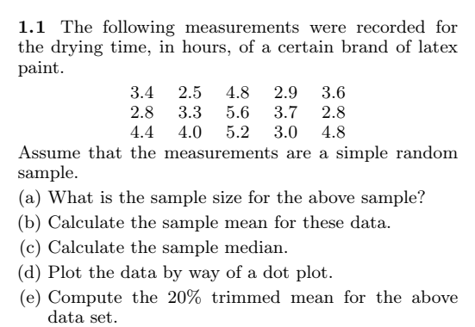
Trimmed Mean (contd.)

Slide 61
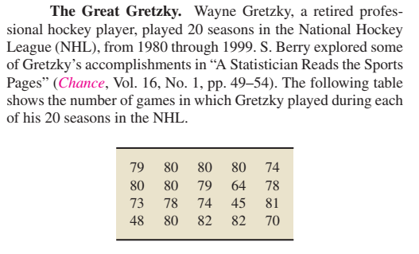
Quiz – I (7/2/19)
Construct (i) Stem & Leaf (ii) Box Plot (iii) Dot plot

Slide 62
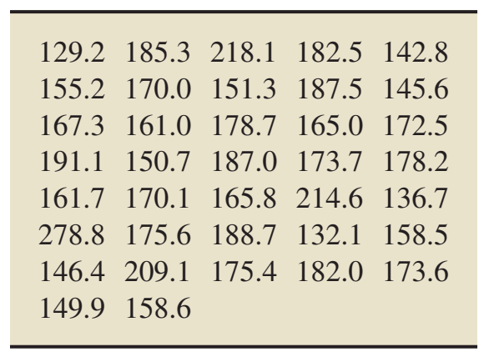
Quiz – I (7/2/19)
The following data represents weights (in pound) for a sample of 18 – 24 year old males.
Construct group frequency distribution consisting of 8 classes and 20 width.
Calculate Mean, Median and Mode
Draw histogram and OGIVE.

